Slide 1
Microsoft Azure Fundamentals
Module 3, Section 3
Dr. Tóth Ádám
toth.adam@inf.unideb.hu

Slide 2
Management and deployment tools
Notes:
https://learn.microsoft.com/training/modules/describe-features-tools-manage-deploy-azure-resources/

Slide 3




Tools for interacting with Azure
Azure portal
Azure PowerShell
Command-Line Interface (CLI)
Azure Cloud Shell
Notes:
https://learn.microsoft.com/training/modules/describe-features-tools-manage-deploy-azure-resources/2-describe-interacting-azure
To get the most out of Azure, you need a way to interact with the Azure environment, the management groups, subscriptions, resource groups, resources, and so on. Azure provides multiple tools for managing your environment, including the:
Azure portal
Azure PowerShell
Azure Command Line Interface (CLI)

Slide 4
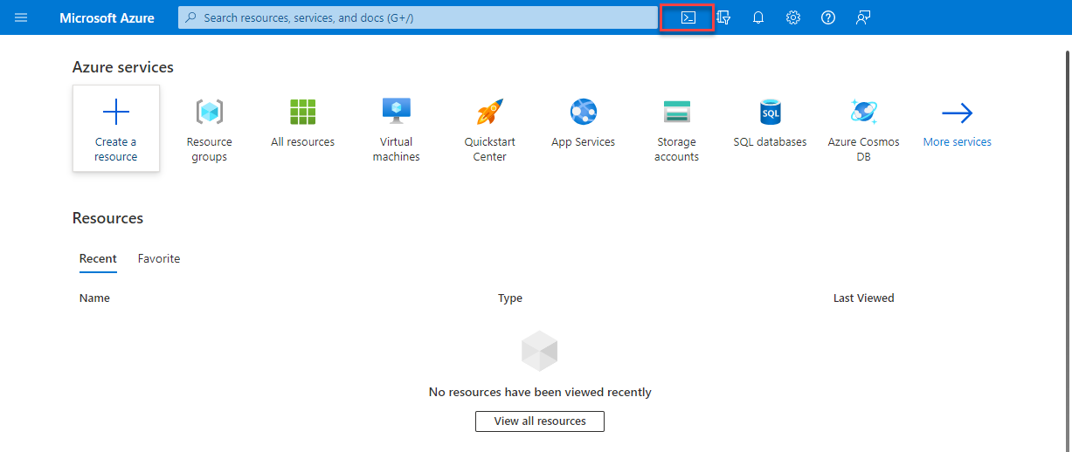
Azure Cloud Shell

Slide 5
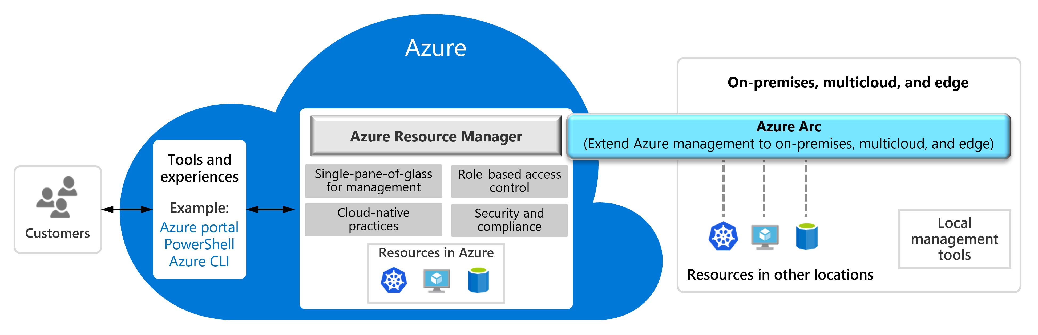
Azure Arc
Notes:
https://learn.microsoft.com/training/modules/describe-features-tools-manage-deploy-azure-resources/3-describe-purpose-of-azure-arc

Slide 6
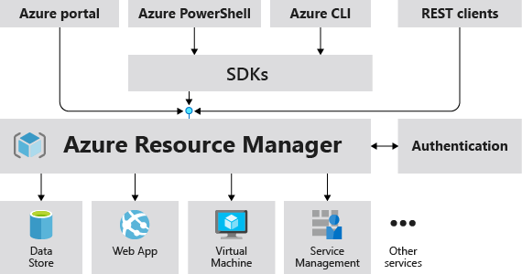
Azure Resource Manager
The Azure Resource Manager (ARM) provides a management layer that enables you to create, update, and delete resources in your Azure subscription.
Notes:
https://learn.microsoft.com/training/modules/describe-features-tools-manage-deploy-azure-resources/4-describe-azure-resource-manager-azure-arm-templates
Provides a management layer that enables you to create, update, and delete resources in your Azure subscription.
Create, configure, manage and delete resources and resource groups.
Organizes resources.
Controls access and resources.
Automates using different tools and SDKs.
Stores layouts in JSON files.
You can view more details about Azure Resource Manager at https://learn.microsoft.com/azure/azure-resource-manager/

Slide 7
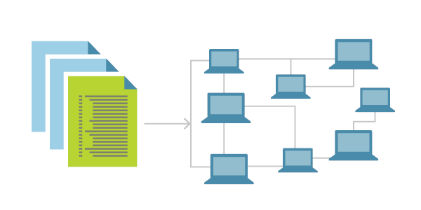
Infrastructure as code
Ensure consistency in deployment across your cloud ecosystem.
Manage configuration at scale.
Rapidly provision additional environments based on a standard configuration and build.
Notes:
https://learn.microsoft.com/en-us/devops/deliver/what-is-infrastructure-as-code#deploy-iac-on-azure

Slide 8
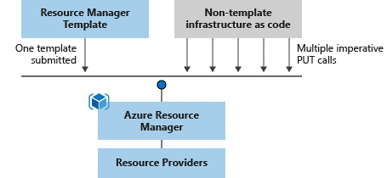
Azure Resource Manager (ARM) templates
Azure Resource Manager (ARM) templates are JavaScript Object Notation (JSON) files that can be used to create and deploy Azure infrastructure without having to write programing commands.
Declarative syntax
Repeatable results
Orchestration
Modular files
Built-in validation
Exportable code
Notes:
https://learn.microsoft.com/training/modules/describe-features-tools-manage-deploy-azure-resources/4-describe-azure-resource-manager-azure-arm-templates
https://learn.microsoft.com/azure/azure-resource-manager/management/overview
https://learn.microsoft.com/azure/azure-resource-manager/templates/overview

Slide 9
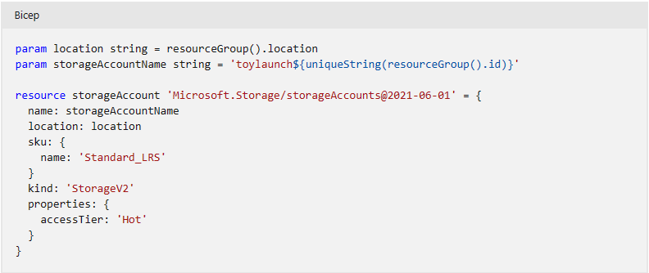
Bicep
Notes:
https://learn.microsoft.com/en-us/azure/azure-resource-manager/bicep/overview?tabs=bicep

Slide 10
Questions
What service helps you manage your Azure, on-premises, and multi-cloud environments?
Azure Arc
Azure Policy
Azure Cloud Manager

Slide 11
Azure monitoring tools
Notes:
https://learn.microsoft.com/training/modules/describe-monitoring-tools-azure/

Slide 12

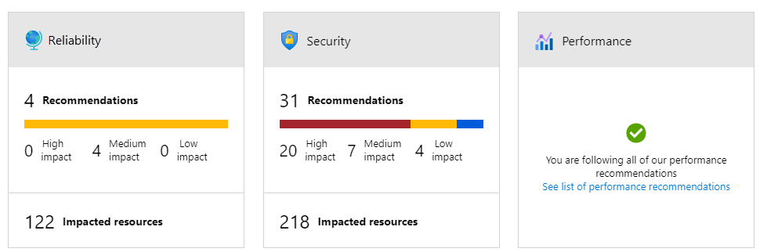
Azure Advisor
Azure Advisor analyzes deployed Azure resources and makes recommendations based on best practices to optimize Azure deployments.
Reliability
Security
Performance
Cost
Operational excellence
Notes:
https://learn.microsoft.com/training/modules/describe-monitoring-tools-azure/2-describe-purpose-of-azure-advisor
Get proactive, actionable, and personalized best practice recommendations.
Improve the performance, security, and availability of your resources.
Identify opportunities to reduce your Azure costs.
Azure Advisor - https://learn.microsoft.com/azure/advisor/advisor-overview

Slide 13
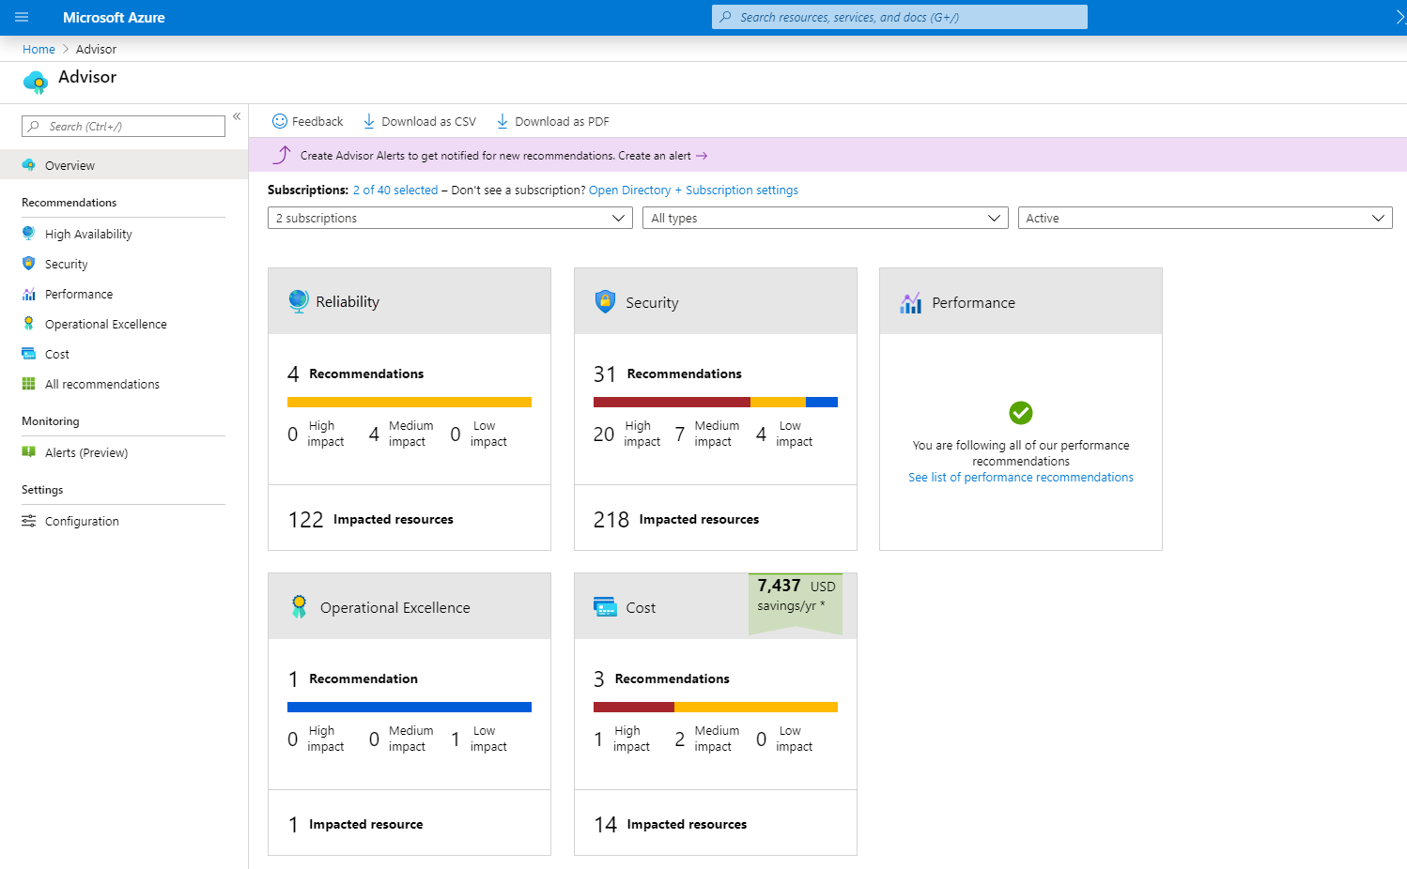
Azure Advisor

Slide 14

Azure Service Health
Azure Service Health is a collection of services that keep you informed of general Azure status, service status that may impact you, and specific resource status that is affecting you.
Azure Status: Global view of the health of all Azure services across all Azure regions.
Service Health: Focused view on only the services and regions that you’re using. If a service is experiencing a problem in a region you’re not using, it won’t show up here.
Resource Health: Tailored view of your actual Azure resources. It provides information about the health of your individual cloud resources.
Notes:
https://learn.microsoft.com/training/modules/describe-monitoring-tools-azure/3-describe-azure-service-health

Slide 15

Azure Monitor
Azure Monitor maximizes the availability and performance of applications and services by collecting, analyzing, and acting on telemetry from cloud and on-premises environments.
Application Insights
Log Analytics
Smart alerts
Automation actions
Customized dashboards
Notes:
https://learn.microsoft.com/training/modules/describe-monitoring-tools-azure/4-describe-azure-monitor

Slide 16
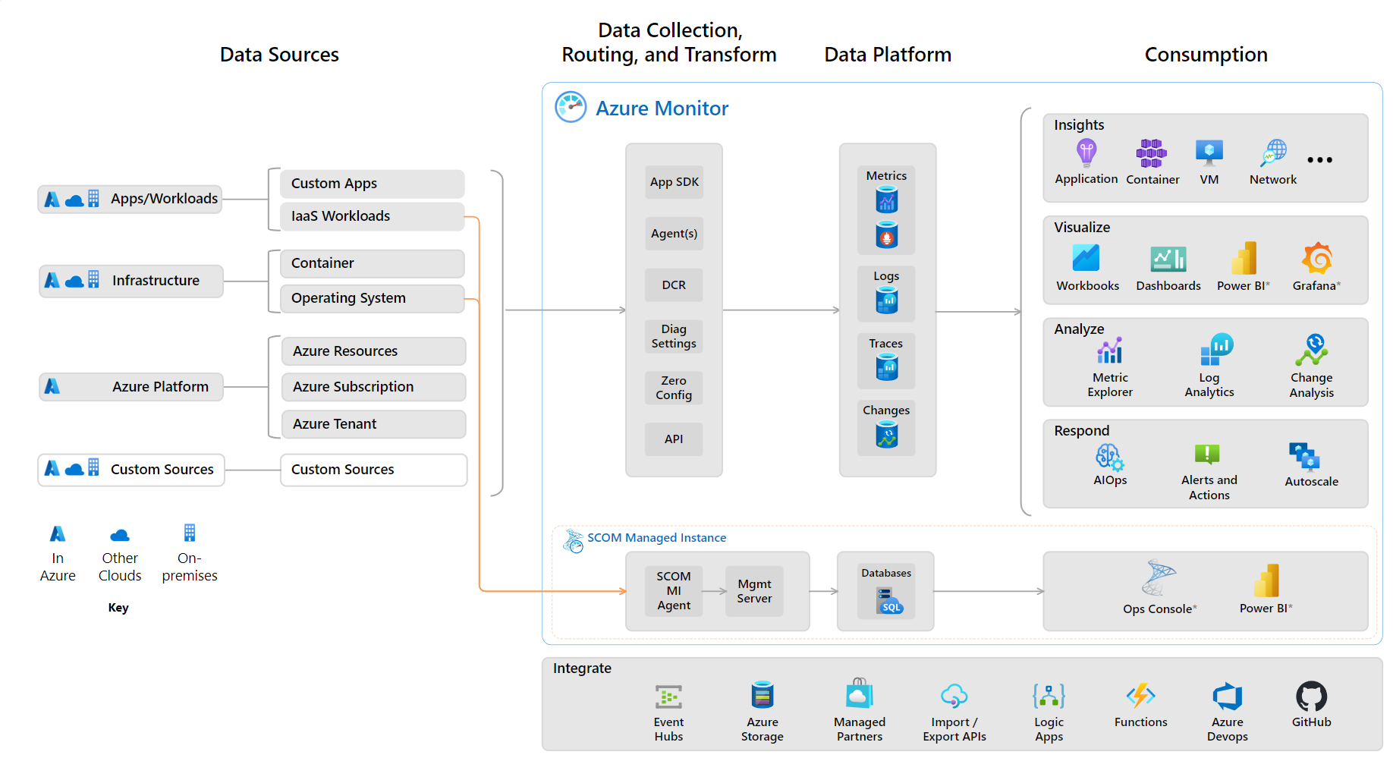
Azure Monitor

Slide 17
Azure Log Analytics
You can write and run log queries on the data gathered by Azure Monitor
Log Analytics is a robust tool that supports both simple, complex queries, and data analysis

Slide 18
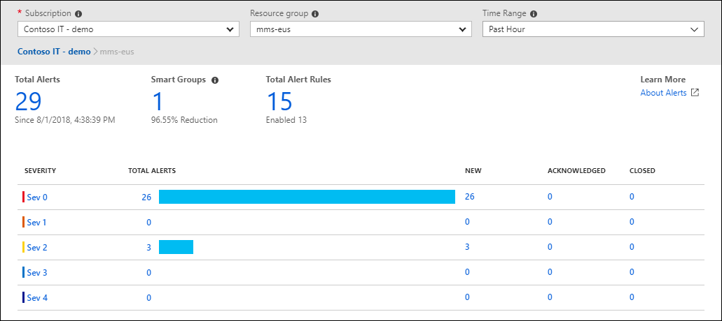
Azure Monitor Alerts
Azure Monitor Alerts are an automated way to stay informed when Azure Monitor detects a threshold being crossed.

Slide 19
Application Insights
An Azure Monitor feature, monitors your web applications.
Az Application Insights képes figyelni az Azure-ban, a helyszínen vagy egy másik felhőkörnyezetben futó alkalmazásokat
Application Insights is capable of monitoring applications that are running in Azure, on-premises, or in a different cloud environment:
Installing SDK
Application Insights agent (C#.NET, VB.NET, Java, JavaScript, Node.js and Python)

Slide 20
Application Insights
You can use it to monitor a broad array of information, such as :
Request rates, response times, and failure rates
Dependency rates, response times, and failure rates, to show whether external services are slowing down performance
Page views and load performance reported by users' browsers
AJAX calls from web pages, including rates, response times, and failure rates
User and session counts
Performance counters from Windows or Linux server machines, such as CPU, memory, and network usage

Slide 21
Questions
Which is not one of the recommendation categories for Azure Advisor?
Reliability
Capacity
Cost

Slide 22
Questions
2. You receive an email notification that virtual machines (VMs) in an Azure region where you have VMs deployed is experiencing an outage. Which component of Azure Service Health will let you know if your application is impacted?
Azure status
Service health
Resource health

